Slide 1
OneButton Healthcare KIT
2 0 1 6 Software Engineering
Team 1

Slide 2
CONTENTS
ONE
TWO
THREE
Introduction
Design
Implementation

Slide 3

ONE
Introduction
PI, Android
SeungYean
Hong
JSP Server
HyeWon
Yun
Android
JiGun Lee
Device Design
SangHyun
Jeon
Arduino
JiHye Lim
Construction
Of
Team 1

Slide 4
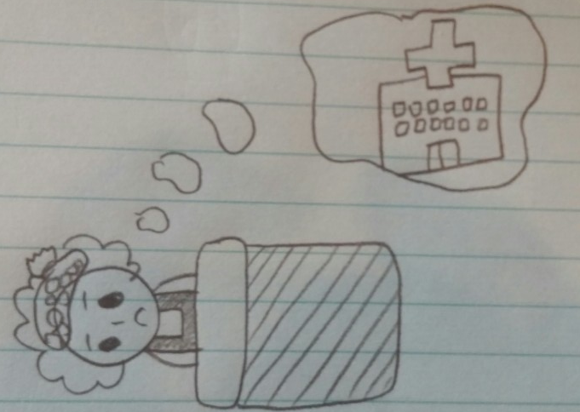
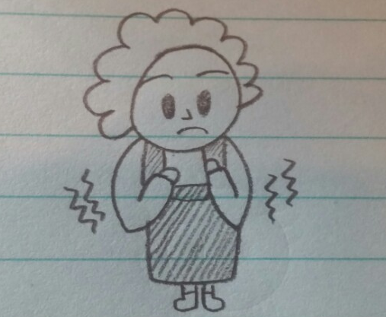
ONE
Introduction
Story Telling
Case 1

Slide 5
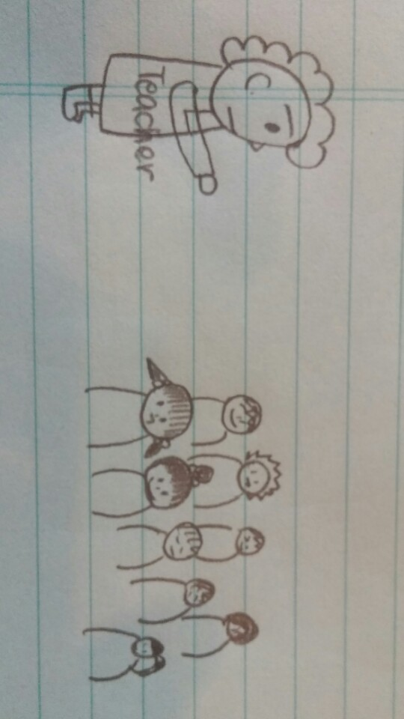
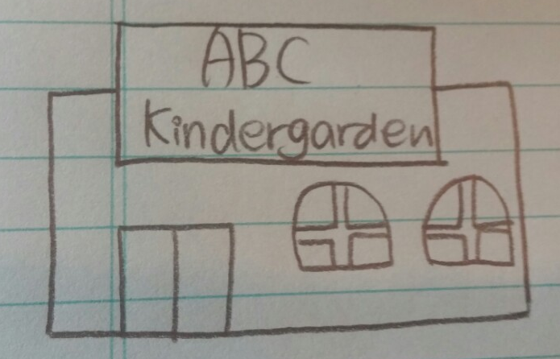
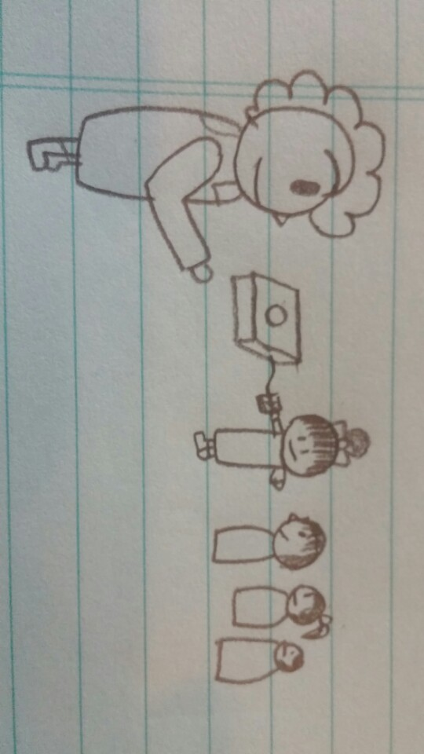
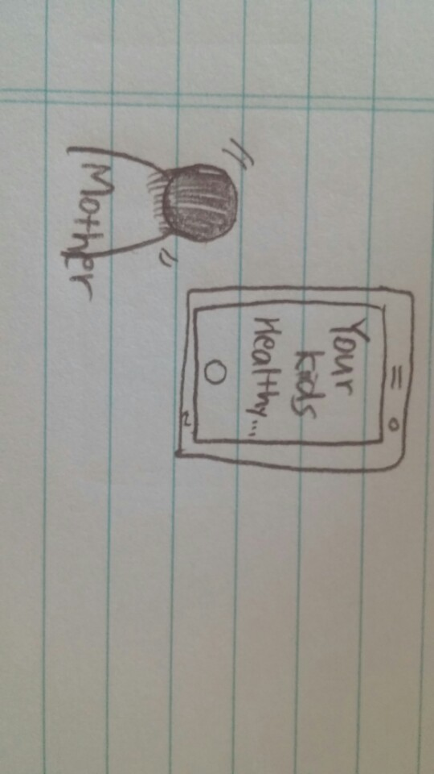
ONE
Introduction
Story Telling
Case 2

Slide 6
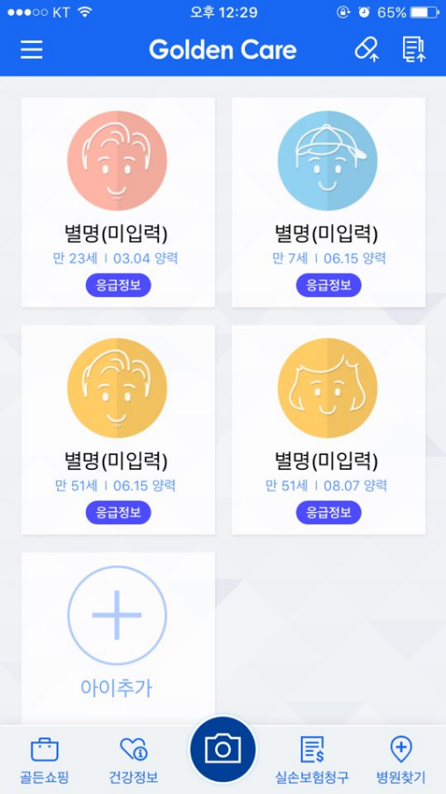
ONE
Introduction
What is our Idea?
Existing Application
Lack of sharing function

Slide 7
ONE
Introduction
What is our Idea?
Frustration in App Usage
Many participants experienced frustration when trying to access app features, something that didn’t surprise one of the interviewers.
“I consider myself a pretty tech-savvy guy,” said Gato Gourley, the study’s project coordinator. “But I had trouble using several of these apps as well – they just weren’t very intuitive.”
In almost all cases, the participants were unable to get to a point where they were productively using any of the applications. For example, participants were only able to complete 51 percent of data-entry tasks across all apps. Even more concerning, participants could successfully retrieve data from the same apps less than half the time (43 percent).
Participants were unable to complete these in-app tasks despite the fact that most had expressed interest in using mobile applications to manage their health concerns.
-UCSF-
Frustration in App Usage

Slide 8
ONE
Introduction
What is our Idea?
Biometric
measurement
One button
operation
Family
healthcare
One button healthcare kit

Slide 9
ONE
Design

Slide 10
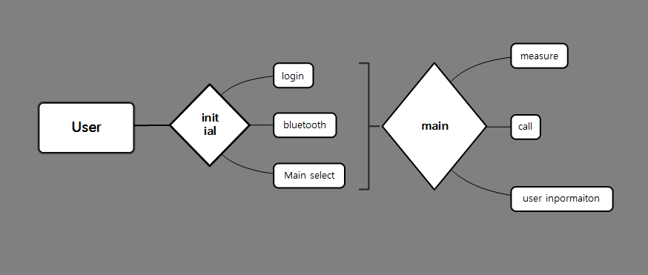
ONE
Design
Data flow

Slide 11
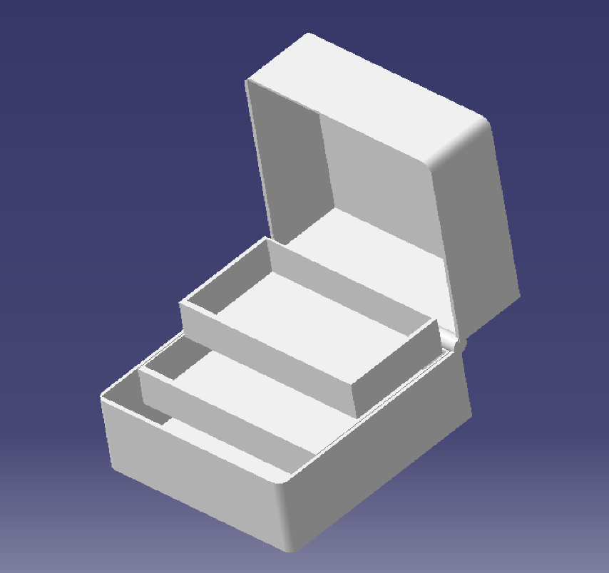
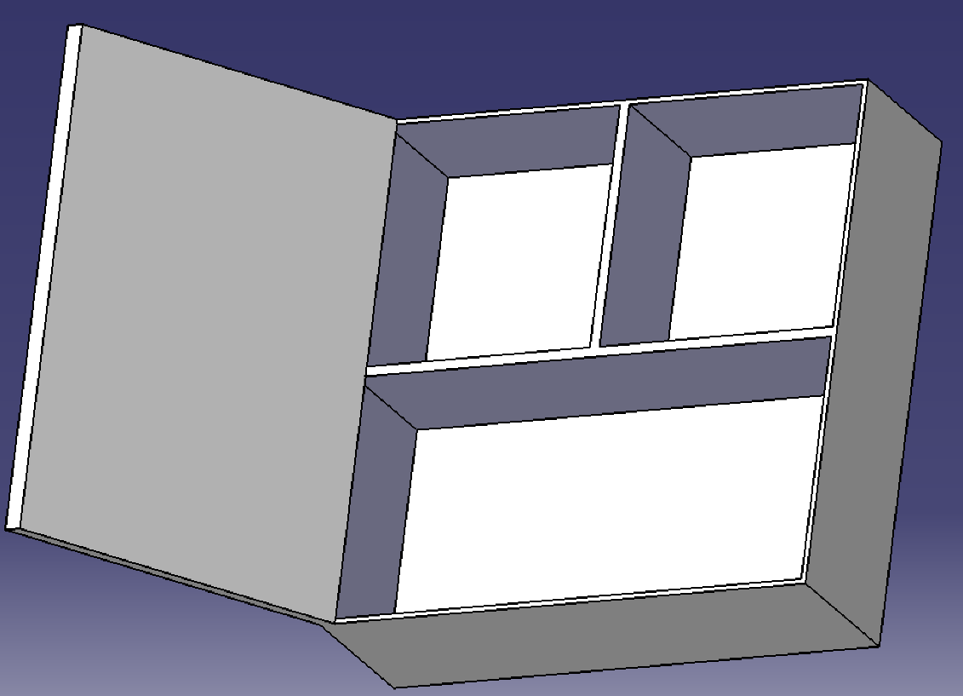
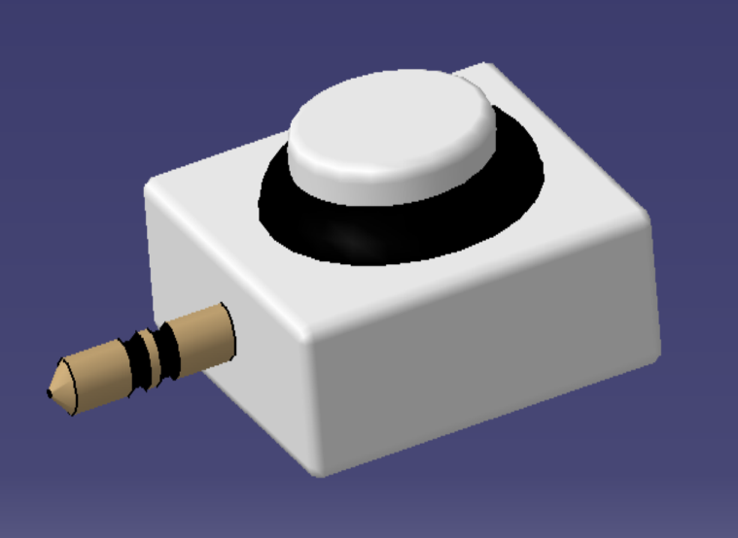
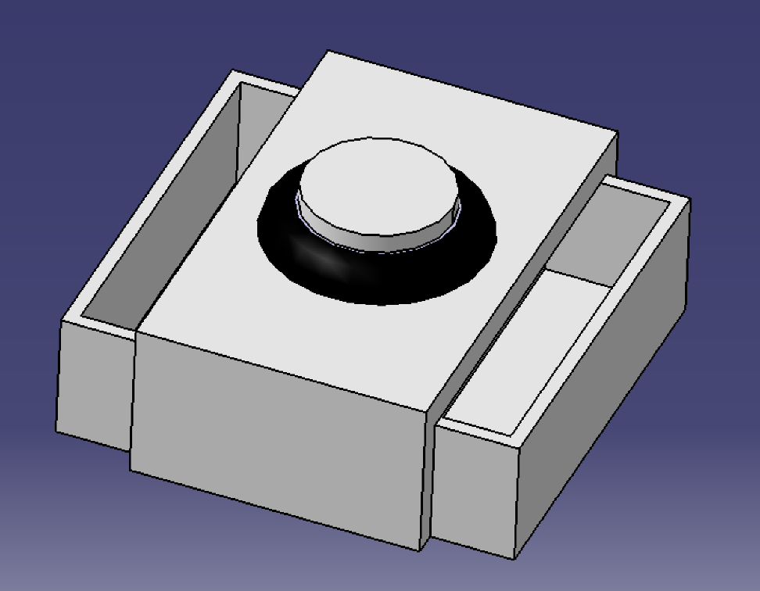
ONE
Design
Design machine

Slide 12
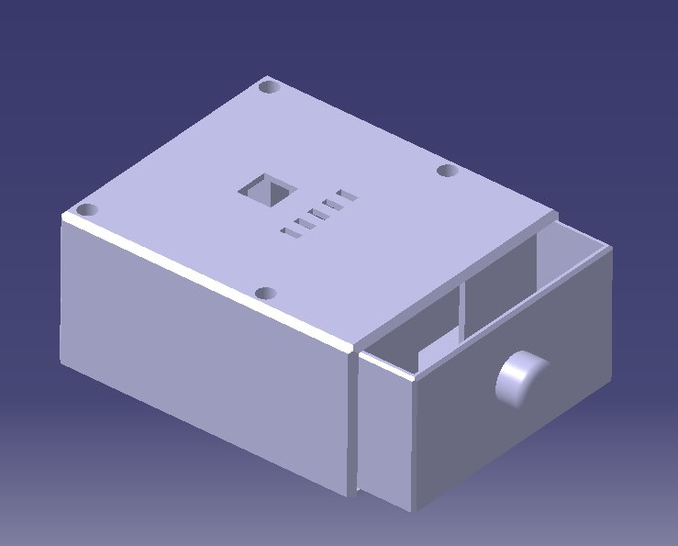
ONE
Design
Design machine
3D printing

Slide 13
ONE
Implementation

Slide 14
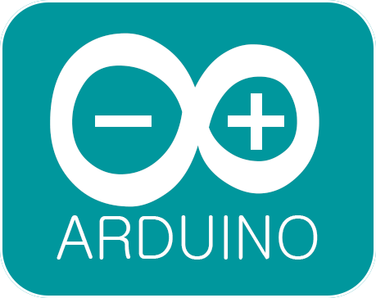



TWO
Implementation
IDE

Slide 15
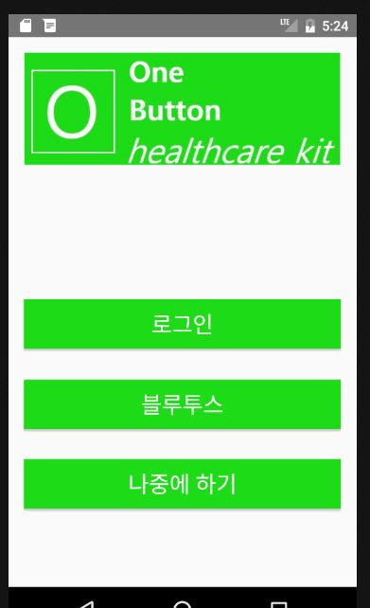

TWO
Implementation
Android App
Initial

Slide 16
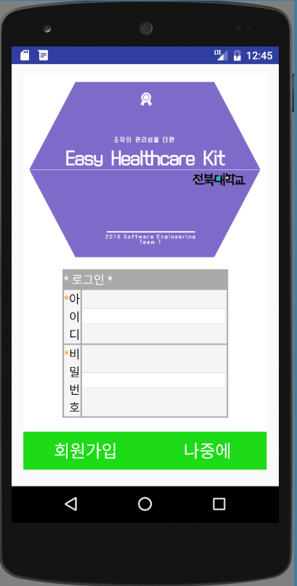

TWO
Implementation
Android App
Server
App
web page

Slide 17
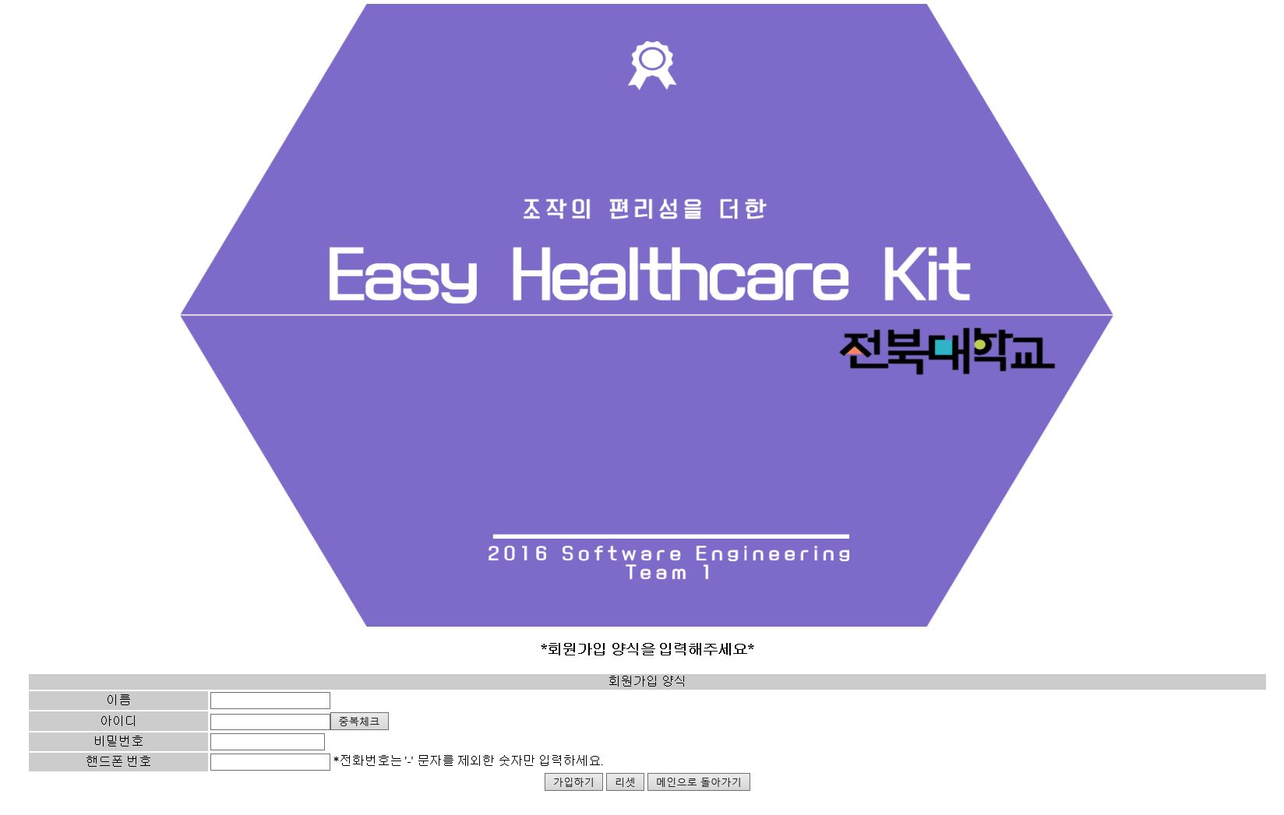
TWO
Implementation
JSP Web page

Slide 18
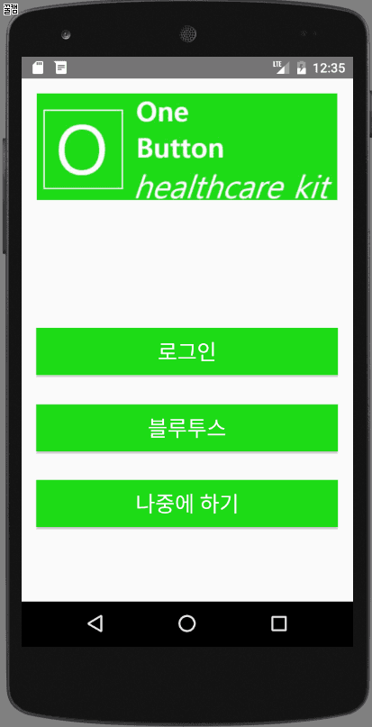
TWO
Implementation
Android App
run

Slide 19
TWO
Implementation
Android App

Slide 20
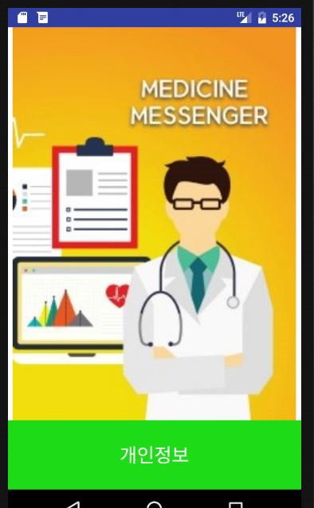
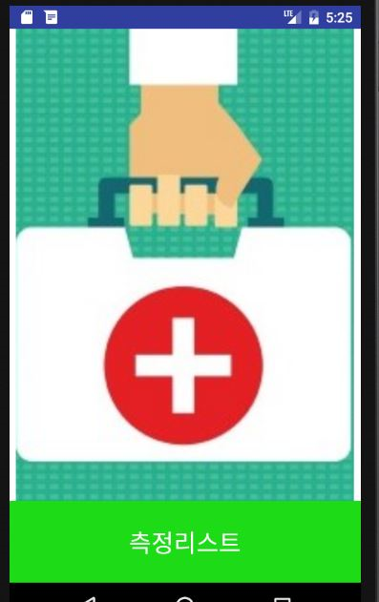
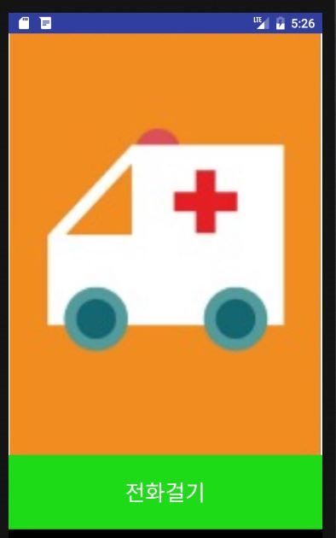
TWO
Implementation
Android App
Button
Main

Slide 21

TWO
Implementation
Android App
run

Slide 22
TWO
Implementation
Android App

Slide 23
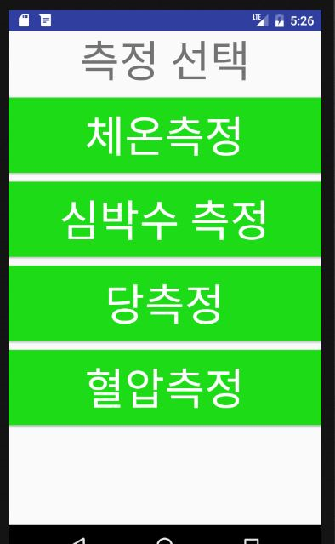
TWO
Implementation
Android App

Slide 24
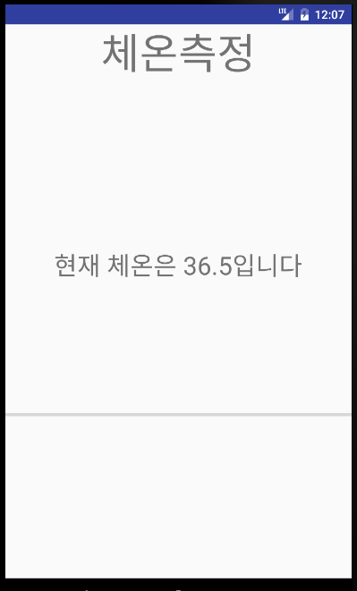
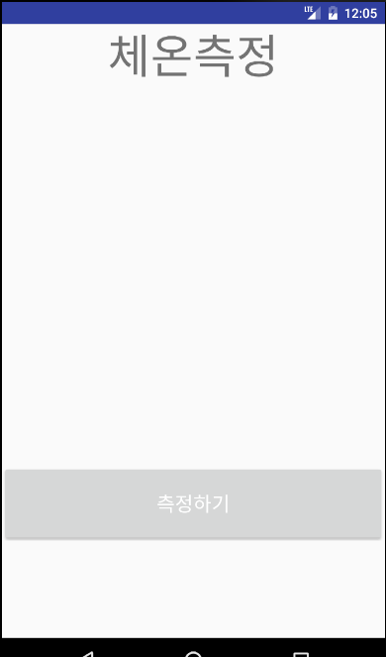
TWO
Implementation
Android App
Button

Slide 25
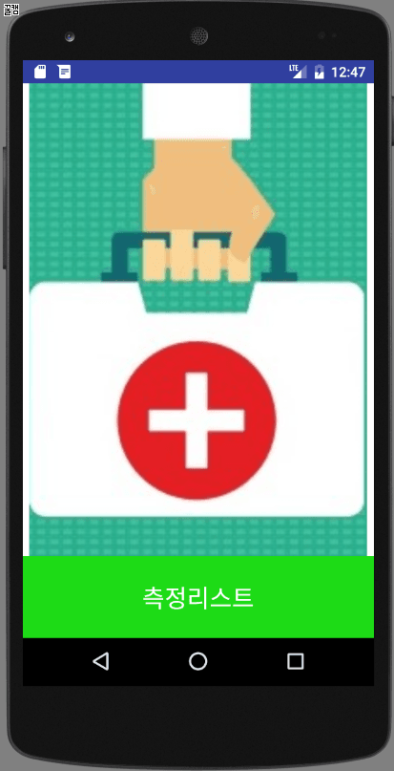
TWO
Implementation
Android App
run

Slide 26
TWO
Implementation
Android App

Slide 27
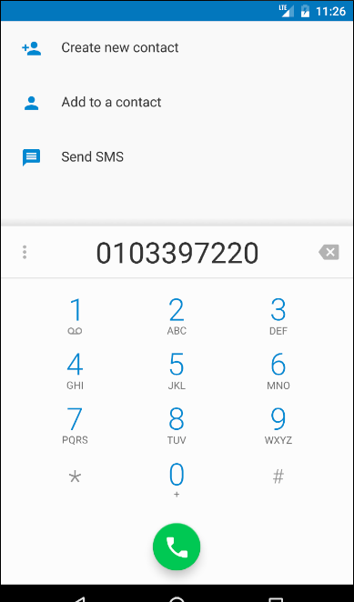
TWO
Implementation
Android App

Slide 28
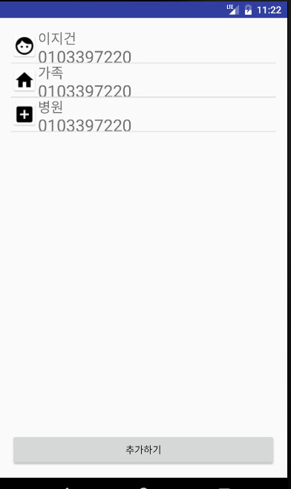
TWO
Implementation
Android App

Slide 29
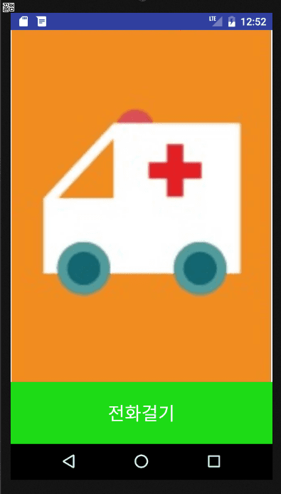
TWO
Implementation
Android App
run

Slide 30
TWO
Implementation
Android App

Slide 31
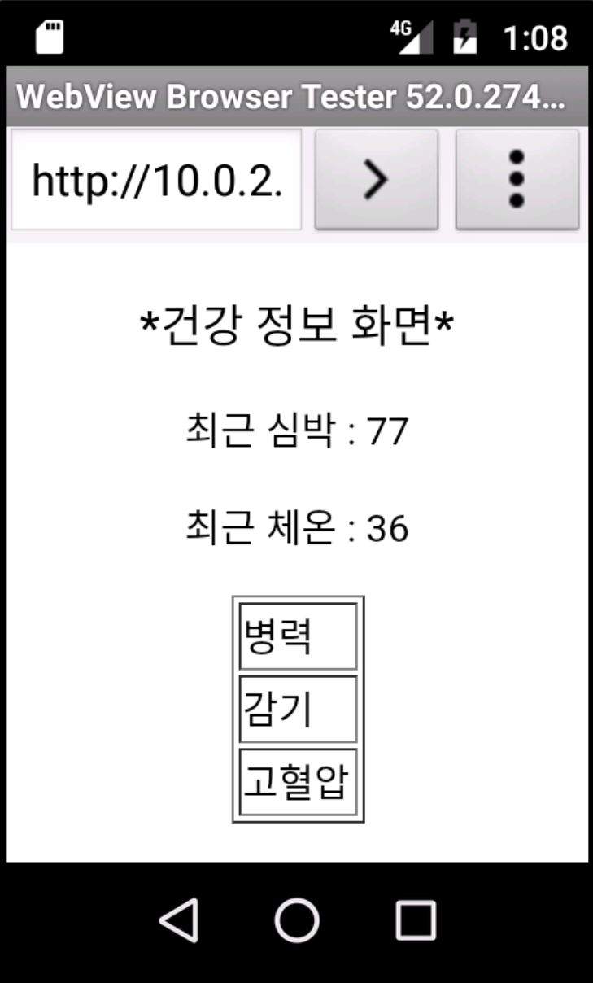
TWO
Implementation
Android App

Slide 32
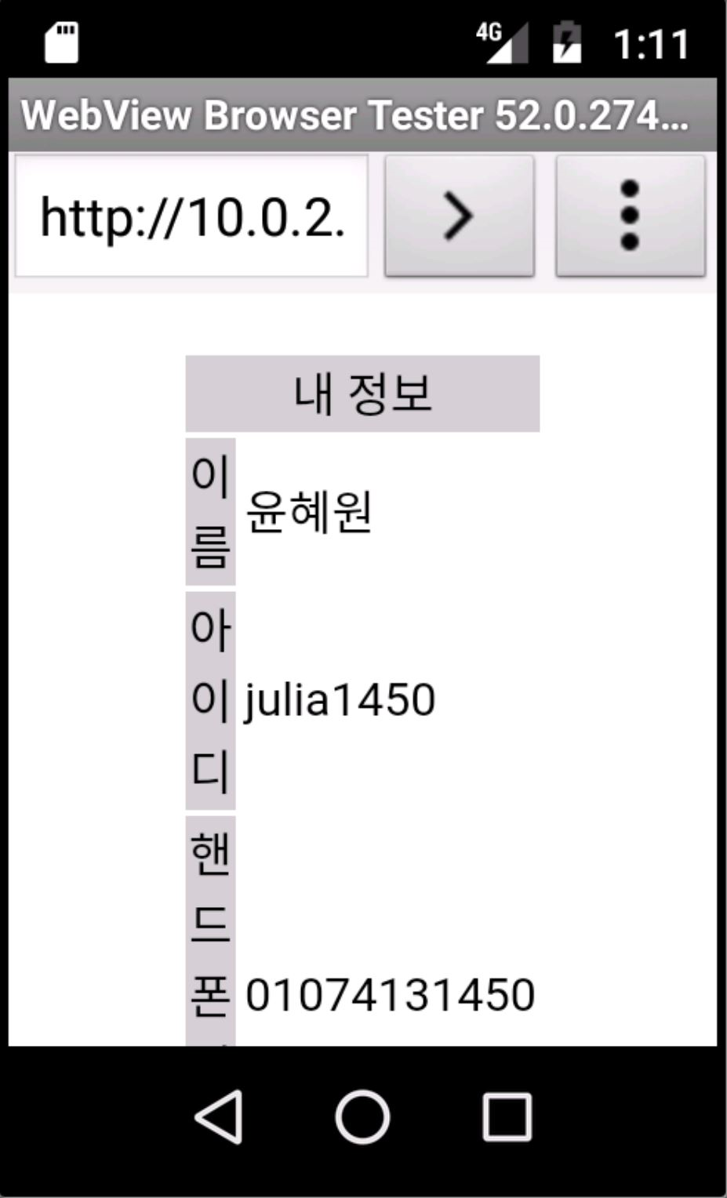
TWO
Implementation
Android App

Slide 33
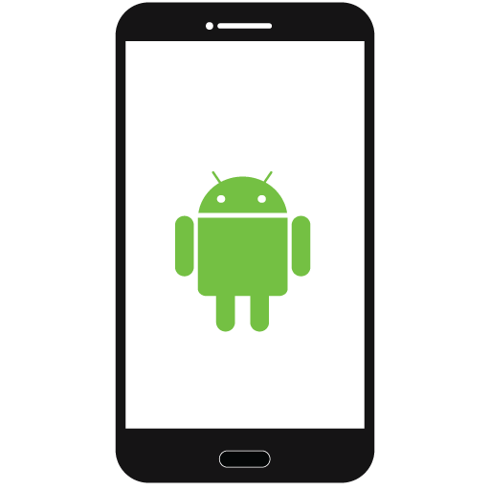
TWO
Implementation
Bluetooth

Slide 34
TWO
Implementation
Arduino

Slide 35
Task
1. Bluetooth Communication
2. Web View
3. Testing

Slide 36

Thank’s for listening

